Slide 1
Meeting 25/03/2022

Slide 2
LSTM model to predict PR
2 Stacked LSTM
128 hidden layers
8 epochs
64 batch size

Slide 3
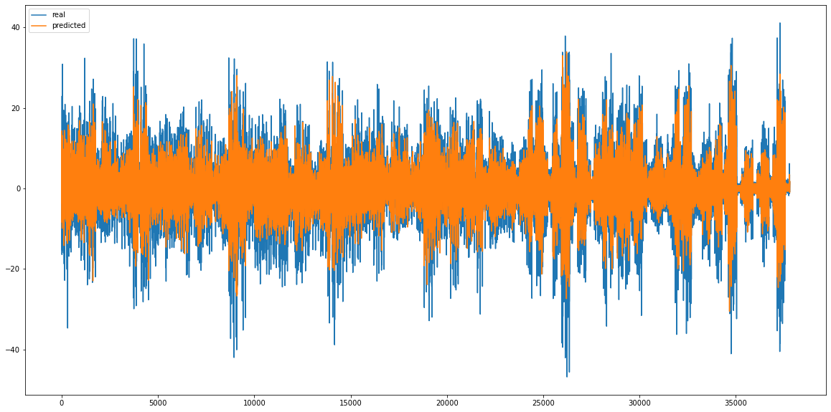
Pitch predictor

Slide 4
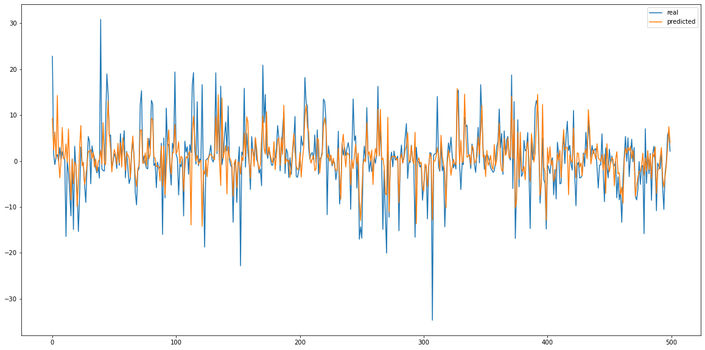
Pitch predictor

Slide 5
Pitch predictor
Real prediction
MSE: 0.00271
RMSE: 0.0521
RMSE denorm: 4.69°
Zero prediction
MSE 0: 0.00511
RMSE 0: 0.0715
RMSE 0 denorm: 6.43°
Improvement on zero prediction:
MSE delta%: 188.47 %
RMSE delta%: 137.28 %

Slide 6
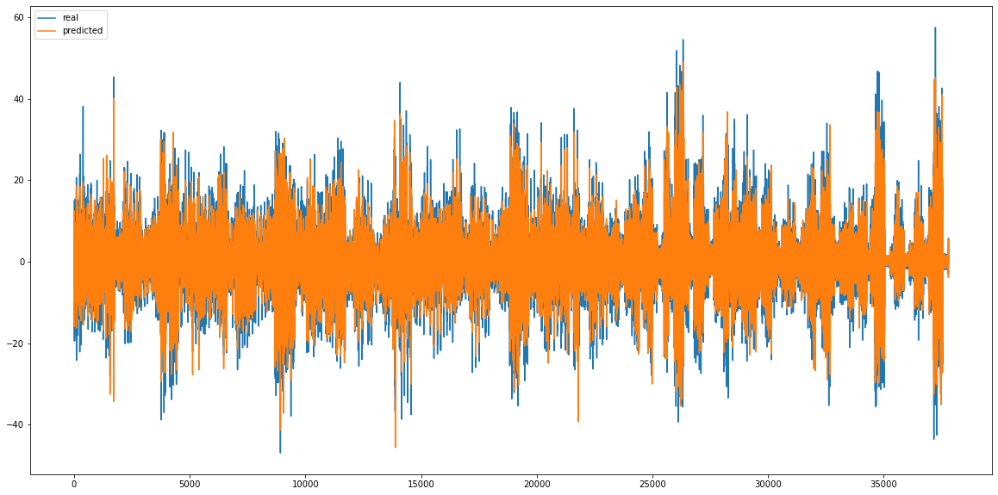
Roll predictor

Slide 7
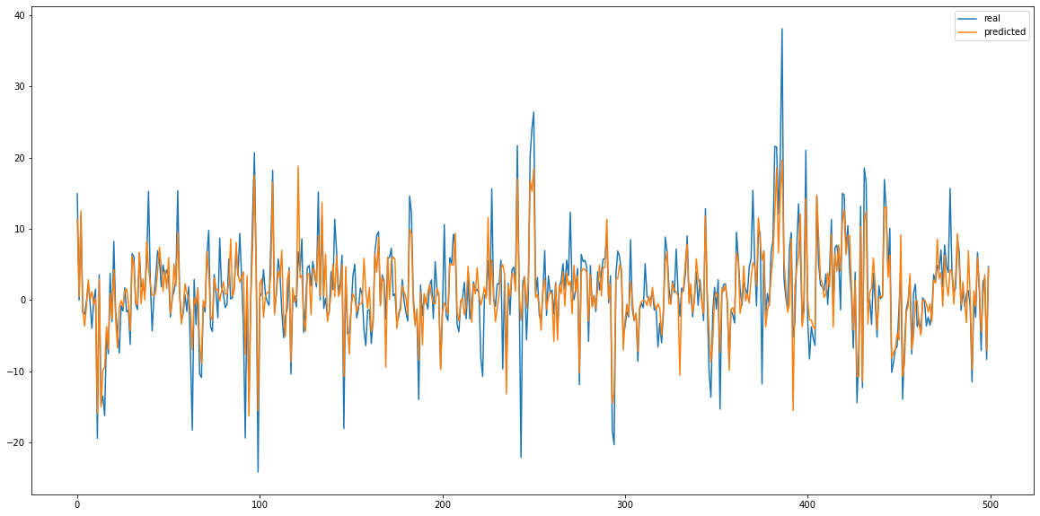
Roll predictor

Slide 8
Roll predictor
Real prediction
MSE: 0.00174
RMSE: 0.0418
RMSE denorm: 3.76°
Zero prediction
MSE 0: 0.00657
RMSE 0: 0.0811
RMSE 0 denorm: 7.29°
Improvement on zero prediction:
MSE delta%: 376.27 %
RMSE delta%: 193.98 %

Slide 9
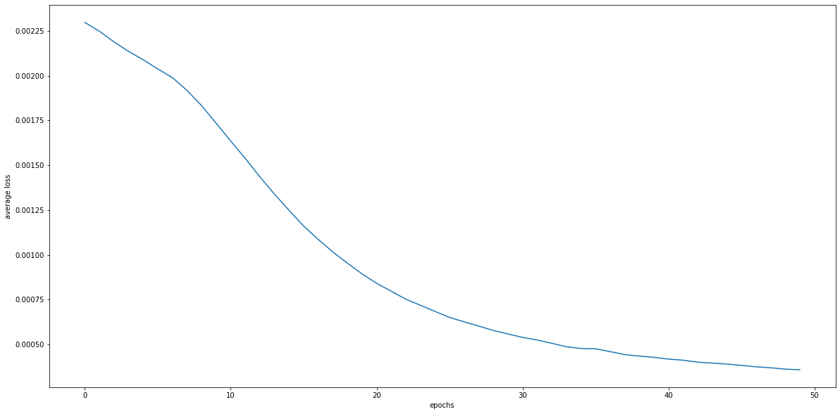
PR predictor

Slide 10
Plato thesis title
“Ship motion prediction using deep learning and sensor fusion”

